Slide 1
20171710
최근표

Slide 2
CONTENTS
01.
Problem
02.
Factorial Solution_1
03.
Factorial Solution_2

Slide 3
Problem
Factorial 값 구하기

Slide 4
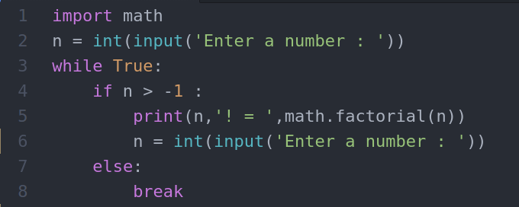
Factorial Solution_1
모듈 이용

Slide 5
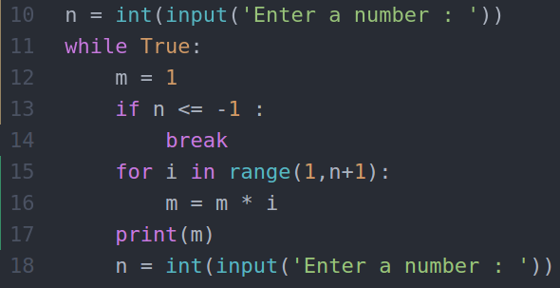
Factorial Solution_2
For문을 이용한 계산

Slide 6
THANK YOU

